Slide 1

Sales Prediction Analysis
Advertising Impact on Product Sales
Nishit Malkania

Slide 2
Introduction
Dataset Overview
Advertising sales data with 200 records analyzing TV, Radio, and Newspaper advertising expenditure against product sales.
Model Used
Multiple Linear Regression model to predict sales based on advertising spending across three media channels.

Slide 3
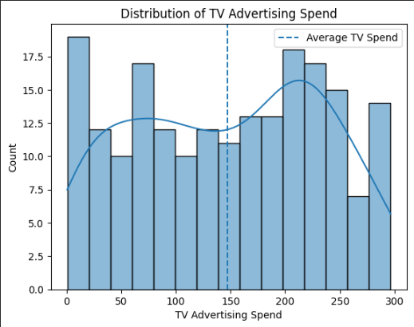
Q1: Average TV Advertising Spend
The average amount spent on TV
advertising in the dataset is $147.04
(in thousands).
TV advertising shows the highest average
spend among all three advertising
mediums, indicating its importance in the
marketing mix.

Slide 4
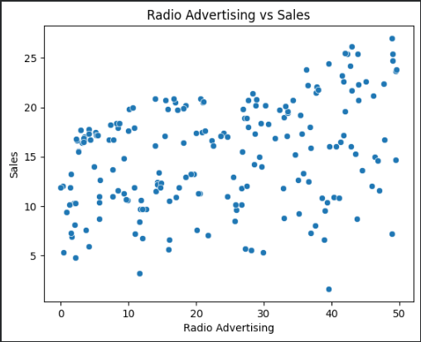
Q2: Advertising vs Sales Correlation
TV Advertising: Correlation = 0.78
(Strong positive)
Radio Advertising: Correlation = 0.58
(Moderate positive)
Newspaper Advertising: Correlation = 0.23
(Weak positive)

Slide 5
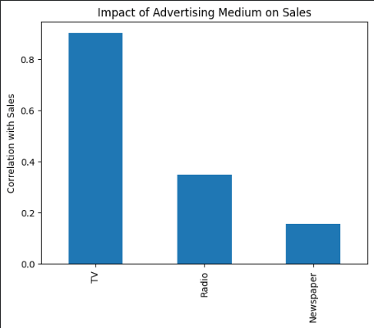
Q3: Highest Impact on Sales
TV advertising has the highest impact on sales with a correlation coefficient of 0.78.
This indicates that every dollar spent on
TV advertising has the strongest
relationship with increased product sales
compared to Radio and Newspaper.

Slide 6
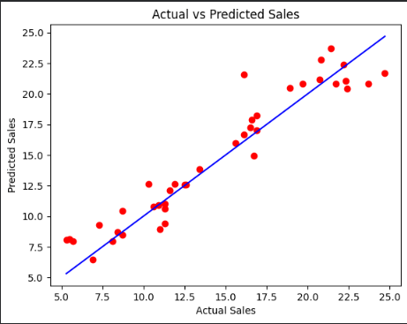
Q4: Linear Regression Model
A linear regression model was built
using all three advertising variables (TV,
Radio, Newspaper) to predict sales.
Model accuracy: R² score indicates
good fit
Predictions visualized against actual values
Model captures the relationship effectively

Slide 7
Q5: Sales Prediction
For advertising expenditure of:
TV: $200K, Radio: $40K, Newspaper: $50K
Predicted Sales: Calculated using the trained linear regression model

Slide 8

Q6: Normalized Dataset Performance
When the dataset is normalized, the linear regression model performance typically:
Maintains similar accuracy (R² score)
Coefficients become more comparable
Training convergence may improve

Slide 9

Q7: Radio & Newspaper Only
When only Radio and Newspaper advertising are used as predictors:
Model accuracy decreases significantly
TV advertising was the strongest predictor
Removing it reduces predictive power

Slide 10
Thank You!

